Slide 1

Psoriasis
Dr. Mohammed Yousif Saeed Al Jaff
Head of department of dermatology
Assistant professor of dermatology.
President of Kurdistan Society of Dermatologists
Consultant of dermatology .

Slide 2
Outline
Definition
Etiology
Pathogenesis
Histology
Types of Psoriasis
Complications
Differential diagnosis
Investigations
Treatment

Slide 3
Psoriasis
Psoriasis is a chronic, non-infectious, inflammatory skin disorder, characterized by well-defined salmonpink plaques bearing large adherent silvery centrally attached scales.
1-3 % of most populations have psoriasis
Uncommon in American black people and almost non-existent in American Indians.
It can start at any age but is rare under 10 years, and appears most often between 15 and 40 years.
Its course is unpredictable but is usually chronic with exacerbations and remissions.

Slide 4
Etiology
The precise cause of psoriasis is still unknown. But there is :
Genetic predisposition
Environmental trigger
There are two key abnormalities in a psoriatic plaque:
Hyperproliferation of keratinocytes
Inflammatory cell infiltrate in which neutrophils, tumour necrosis factor and probably Th17 type T lymphocytes predominate.
Both of these abnormalities can induce the other, leading to a vicious cycle of keratinocyte proliferation and inflammatory reaction

Slide 5
Predisposing factors
Trauma If the psoriasis is active (Köbner phenomenon)
Infection Tonsillitis caused by β-haemolytic streptococci often triggers guttate psoriasis.
Hormonal Psoriasis frequently improves in pregnancy only to relapse postpartum.
Sunlight Improves most psoriatics but 10% become worse.
Drugs Antimalarials, beta-blockers, IFN-α and steroid
Cigarette smoking and alcohol
Emotional upset

Slide 6
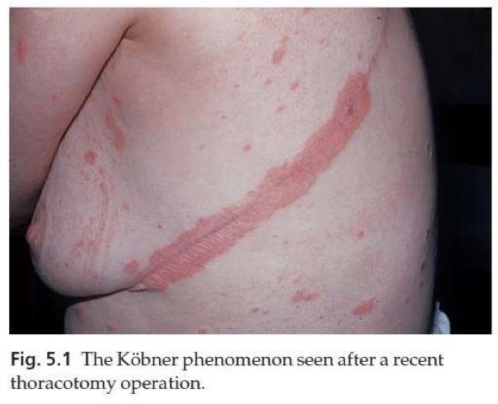

Slide 7
Pathogenesis

Slide 8
Genetics
There are two inheritance modes.
One type has onset in youth and a more common family history of psoriasis, and the other has onset in late adulthood in patients without obvious family history.
Inheritance is polygenic
A child with one affected parent has a 16% chance of developing the disease, and this rises to 50% if both parents are affected.
Psoriatic fathers are more likely to pass on the disease to their children than are psoriatic mothers.
If non-psoriatic parents have a child with psoriasis, the risk for subsequent children is about 10%.

Slide 9
Genetics
Concordant is 70% of monozygotic twins but in only 20% of dizygotic ones.
Early-onset psoriasis shows a genetic linkage with a psoriasis susceptibility locus (PSOR-1) located on 6p21
PSORS-1 is the most important locus in psoriasis, accounting for up to 50% of genetic susceptibility to the disease
Eight other loci (PSORS-2 to 9) have been identified.
HLA-Cw6 genotype developing psoriasis is 20 times that of those without it

Slide 10
Epidermal cell kinetics
The epidermis of psoriasis replicates too quickly
Keratinocytes proliferate out of control, and an excessive number of germinative cells enter the cell cycle.
The growth fraction of epidermal basal cells is greatly increased to almost 100% compared with 30% in normal skin
The epidermal turnover time is greatly shortened, to less than 10 days compared with 30 to 60 days in normal skin.

Slide 11
Inflammation
Immune events may well have a primary role in the pathogenesis of the disease of psoriasis
Inflammatory cells especially neutrophils and lymphocytes
Release of inflammatory cytokines and mediators

Slide 12
Histology
The main changes are the following.
Parakeratosis (nuclei retained in the horny layer).
Irregular thickening of the epidermis over the rete ridges, but thinning over dermal papillae. Bleeding may occur when scale is scratched off (Auspitz’s sign).
Epidermal polymorphonuclear leucocyte infiltrates and micro-abscesses (described originally by Munro).
Dilated and tortuous capillary loops in the dermal papillae.
T-lymphocyte infiltrate in upper dermis.

Slide 13
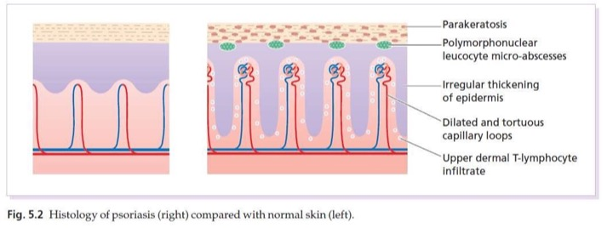
Histology

Slide 14
Plaque pattern
Most common type
Lesions are well demarcated and range from a few millimetres to many centimetres in diameter
The lesions are pink or red with large, centrally adherent, silvery white, polygonal scales.

Slide 15
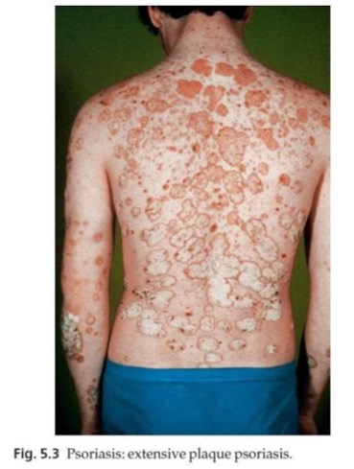

Slide 16
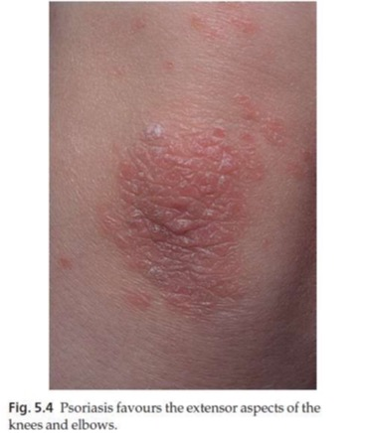
Symmetrical sites on the elbows, knees, lower back and scalp are sites of predilection

Slide 17
Guttate psoriasis
The word ‘guttate’ means ‘drop-shaped’.
Seen in children and adolescents
May be the first sign of the disease
Often triggered by streptococcal tonsillitis.
Numerous small round red macules come up suddenly on the trunk and soon become scaly
The rash often clears in a few months but plaque psoriasis may develop later

Slide 18
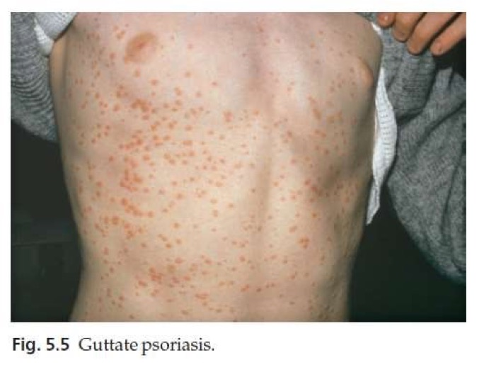

Slide 19
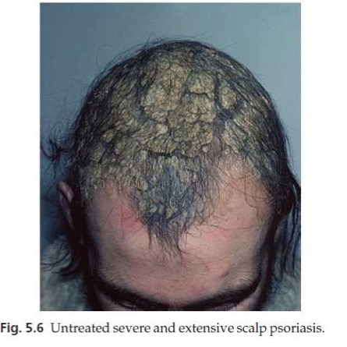
Scalp
often involved
the psoriasis overflows just beyond the scalp margin
Significant hair loss is rare

Slide 20
Involvement of the nails is common
Thimble pitting
Onycholysis (separation of the nail from the nail bed
Sometimes subungual hyperkeratosis

Slide 21
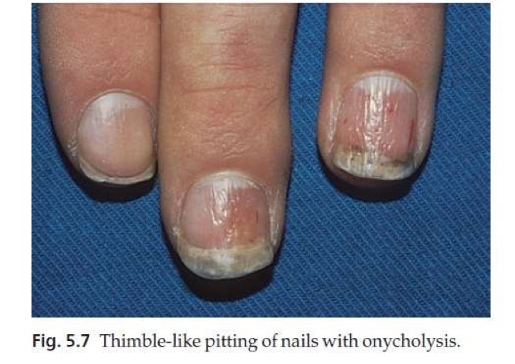

Slide 22
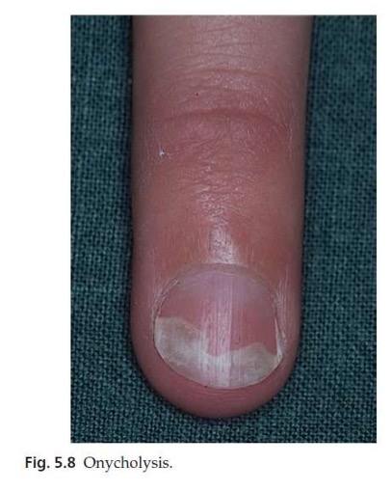

Slide 23
Flexures
Psoriasis of the submammary, axillary and anogenital folds is not scaly although the glistening sharply demarcated red plaques often with fissuring in the depth of the fold, are still readily recognizable.
Flexural psoriasis is most common in women and in the elderly, and is more common among HIV infected individuals

Slide 24
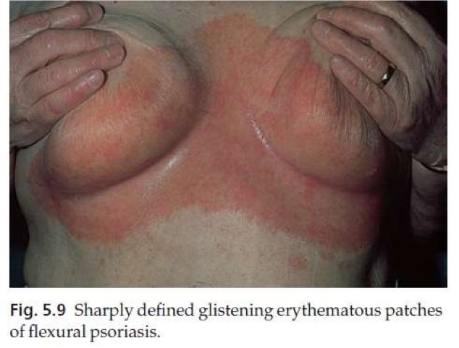

Slide 25
Palms and soles
Palmar psoriasis may be hard to recognize, as its lesions are often poorly demarcated and barely erythematous.
The fingers may develop painful fissures.
At other times lesions are inflamed and studded with 1–2 mm pustules (palmoplantar pustulosis)

Slide 26
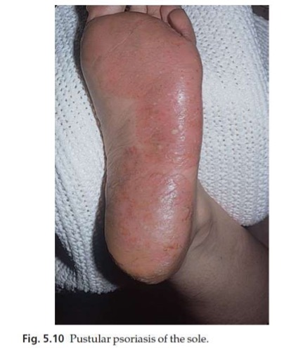

Slide 27
Erythrodermic psoriasis
Rare
Sparked off by:
Irritant effect of tar or dithranol
By a drug
By the withdrawal of potent topical or systemic steroids.
The skin becomes universally and uniformly red with variable scaling.
Malaise is accompanied by shivering and the skin feels hot and uncomfortable.

Slide 28
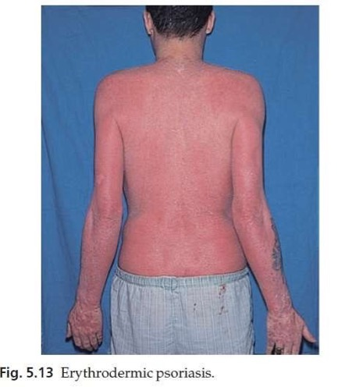

Slide 29
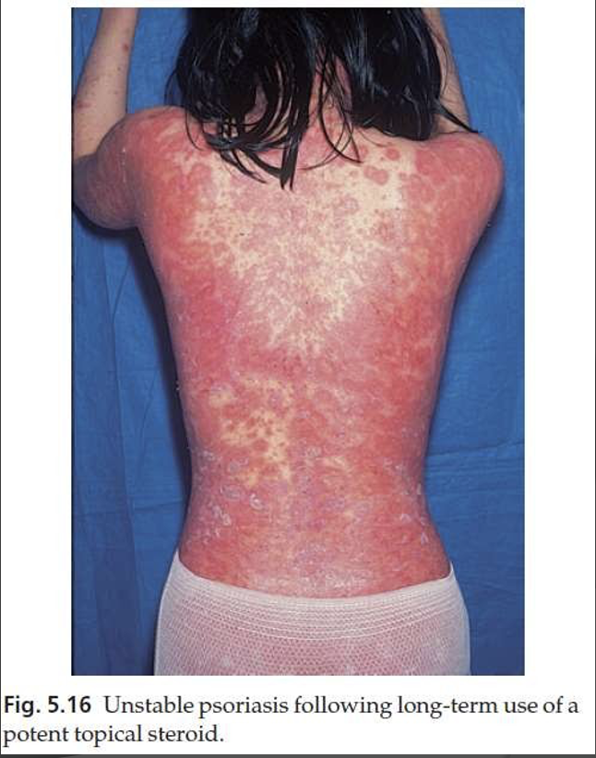
Unstable psoriasis
Following long-term use of potent topical steroid

Slide 30
Complications
Psoriatic arthropathy
Occurs in about 5–20% of psoriatics.
Distal arthritis involves the terminal interphalangeal joints of the toes and fingers, especially those with marked nail changes
Involvement of a single large joint; one that mimics rheumatoid arthritis and may become mutilating
Tests for rheumatoid factor are negative and nodules are absent.
In patients with spondylitis and sacroiliitis there is a strong correlation with the presence of HLA-B27.

Slide 31
Differential diagnosis
Discoid eczema
Seborrhoeic eczema
Pityriasis rosea
Secondary syphilis
Cutaneous T-cell lymphoma
Tinea unguium

Slide 32
Investigations
Biopsy is seldom necessary
Throat swabbing for β-haemolytic streptococci is needed in guttate psoriasis.
Skin scrapings and nail clippings may be required to exclude tinea.
Radiology and tests for rheumatoid factor are helpful in assessing arthritis

Slide 33
Treatment
General measures
Explanations and reassurances
Treatment must never be allowed to be more troublesome than the disease itself.
At present there is no cure for psoriasis; all treatments are suppressive and aimed at either inducing a remission or making the condition more tolerable.
Spontaneous remissions will occur in 50%of patients.
Concomitant anxiety and depression should be treated on their own merits

Slide 34
Treatment
Local treatments
Vitamin D analogues
Calcipotriol (calcipotriene, USA), calcitriol and tacalcitol
Used for mild to moderate psoriasis affecting less than 40% of the skin
Patients like calcipotriol because it is odourless, colourless and does not stain.
It seldom clears plaques of psoriasis completely, but does reduce their scaling and thickness.
Local and usually transient irritation may occur with the recommended twice-daily application

Slide 35
Treatment
Local retinoids
Tazarotene is a topically active retinoid
It is recommended for chronic stable plaque psoriasis on the trunk and limbs covering up to 20% of the body.
Its main side-effect is irritation
The drug should not be used in pregnancy or during lactation or children below 12 year.
Females of child-bearing age should use adequate contraception during therapy

Slide 36
Treatment
Topical corticosteroids
Topical corticosteroids are most helpful and use them as the mainstay of their long-term management of stable plaque psoriasis.
Patients like them because they are clean and reduce scaling and redness.
Used if other treatments are ineffective or contraindicated or for localized psoriasis
Side effects
Dermal atrophy
Tachyphylaxis
Early relapses
The occasional precipitation of unstable psoriasis
Rarely, in extensive cases, of adrenal suppression caused by systemic absorption.

Slide 37
Treatment
Dithranol (anthralin)
It inhibits DNA synthesis and form free radicals of oxygen.
Dithranol is too irritant to apply to the face, the inner thighs, genital region or skin folds
It also stain clothes purple–brown

Slide 38
Treatment
Coal tar preparations
The less refined tars are smelly, messy and stain clothes, but are more effective than the cleaner refined preparations.
Calcineurin inhibitors (topical immunomodulators)
Both tacrolimus and pimecrolimus have been used, but they are usually too weak to do much except for psoriasis on the face, genitals or intertriginous areas

Slide 39
Treatment
Ultraviolet radiation
Most patients improve with natural sunlight and should be encouraged to sunbathe
Both broadband and narrowband UVB can be used.
Narrowband UVB at wavelength 311 nm is especially effective for clearing psoriasis while minimizing exposure to potentially carcinogenic wavelengths less than 300 nm
The main risk of UVB therapies in the short term is acute phototoxicity (sunburn-like reaction) and, in the long term, the induction of photodamage and skin cancer

Slide 40
Special situations
Scalp psoriasis
This is often recalcitrant.
Oily preparations containing 3–6% salicylic acid are useful
They should be rubbed into the scalp three times a week and washed out with a tar shampoo 4–6 h later.
Salicylic acid and tar combinations are also effective.
Guttate psoriasis
A course of penicillin V or erythromycin is indicated for any associated streptococcal throat infection.
Bland local treatment is often enough as the natural trend is towards remission.
Suitable preparations include emulsifying ointment and zinc and ichthammol cream. Tar–steroid preparations are reasonable alternatives.

Slide 41
Systemic treatment
A systemic approach should be considered
For extensive psoriasis (more than 20% of the body surface) that fails to improve with prolonged courses of tar or dithranol
For patients whose quality of life is low

Slide 42
PUVA
An oral dose of 8-methoxypsoralen (8-MOP) or 5- methoxypsoralen (5-MOP) is followed by exposure to long-wave ultraviolet radiation (UVA: 320–400 nm).
Inhibits DNA synthesis and epidermal cell division.
Psoralens may also be administered in bath water for those unable to tolerate the oral regimen.
Treatment is given two or three times a week with increasing doses of UVA, depending on erythema production and the therapeutic response.
Protective goggles are worn during radiation and UVA opaque plastic glasses must be used after taking the tablets and for 24 h after each treatment

Slide 43
PUVA
Side-effects
Painful erythema is the most common side-effect
One-quarter of patients itch during and immediately after radiation
Long-term side-effects include premature ageing of the skin (with mottled pigmentation, scattered lentigines, wrinkles and atrophy), cutaneous Malignancies , cataract formation. The use of UVA- blocking glasses for 24 h after each treatment should protect against the latter.
The long-term side-effects relate to the total amount of UVA received over the years; this must be recorded and kept as low as possible

Slide 44
Retinoids
Acitretin (10–25 mg/day) is an analogue of vitamin A, and is one of the few drugs helpful in pustular psoriasis
Retinoids and PUVA act synergistically and are often used together in the so-called Re-PUVA regimen. This clears plaque psoriasis quicker than PUVA alone, and needs a smaller cumulative dose of UVA
Side Effects
Minor side effects are frequent and dose related. They include dry lips, mouth, vagina and eyes, peeling of the skin, pruritus and unpleasant paronychia.
Hair thinning or loss is common
Liver damage and hyperlipidemia
Most important side-effect is teratogenicity so acitretin should not normally be prescribed to women of child-bearing age.
Effective oral contraceptive measures must be taken for 2 years after treatment has ceased.
Blood donation should be avoided for a similar period

Slide 45
Methotrexate
Inhibition of both dihydrofolate reductase, and (AICAR) transferase
Folate supplementation may reduce methotrexate toxicity,
Minor and temporary side effects, such as nausea and malaise, are common in the 48 h after administration.
The most serious drawback to this treatment is hepatic fibrosis
Monitored by liver biopsy to exclude active liver disease has been advised for those with risk factors, and repeated after every cumulative dose of 1.5–2 g or serial assays of serum procollagen III aminopeptide (PIIINP)
Blood checks to exclude marrow suppression, and to monitor renal and liver function, should also be performed
The drug is teratogenic and should not be given to females in their reproductive years. Oligospermia has been noted in men and fertility may be lowered

Slide 46
Ciclosporin
Inhibits cell-mediated immune reactions
Effective in severe psoriasis
Side-effects of long-term treatment include hypertension, kidney damage and persistent viral warts with a risk of skin cancer
Combination therapy
If psoriasis is resistant to one treatment, a combination of treatments used together may be the answer. Combination treatments can even prevent side-effects by allowing less of each drug to be used.

Slide 47
Anti TNF-a
Etanercept, recommended as the first line biological agent
Infliximab
Inhibits T-cell activation drugs:
Alefacept
Efalizumab
They all are very effective, but also very costy

Slide 48
Thanks

